Slide 1
LIBRARY MANAGEMENT SYSTEM
Thogiti Sri Durga
Sabiha Shaik
Dara Lavanya
Paripati Vandana
Batch No : 429

Slide 2
About Me:
Back Ground : B.Tech
Why I Want To Learn Data Science:
I Want To Learn Data Science To Analyze Data, Gain Meaningful Insights, And Make Better Data-driven Decisions. It Also Offers Strong Career Opportunities And Helps Solve Real-world Problems Using Data.
Work Experience : No Prior Work Experience
LinkedIn :
Github:

Slide 3
Outliers
Introduction
Objective of the Project
ER Diagram
Schema Explanation
Key Analysis Explaantion
Final Business Insights and Recommendations
Conclusion
Experience & Challenges

Slide 4
INTRODUCTION
This project is an SQL-based Library Management System developed to understand how real-world databases are designed and managed.
The system stores and organizes data related to books, authors, library branches, borrowers, and book loans in a structured way.
Proper table relationships are created using primary and foreign keys to maintain data integrity and consistency.
Database normalization is applied to avoid data duplication and improve efficiency.
SQL queries using joins, aggregate functions, and conditions are written to extract meaningful information.
The project reflects practical experience in SQL fundamentals and real-life data handling.

Slide 5

Objective of the Project
To design and implement a structured relational database for a library management system
To define tables with appropriate primary keys and foreign key constraints ensuring data integrity
To model real-world library operations by establishing relationships between books, branches, borrowers, and transactions
To perform SQL-based data analysis using joins, aggregations, and filtering techniques
To extract meaningful insights that support decision-making and operational efficiency

Slide 6
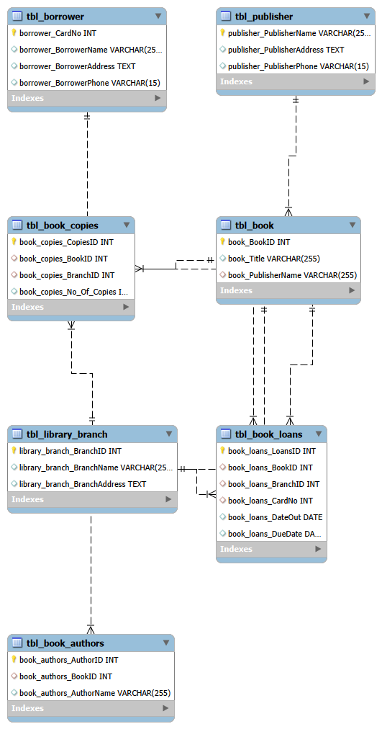
ER DIAGRAM

Slide 7
Schema Explanation
The database consists of seven interconnected tables
Each table represents a real-world entity such as books, publishers, loans,borrowers and author
Relationships are maintained using foreign keys to ensure data consistency
The Book Loans table acts as a transaction table connecting books, borrowers, and branches
The schema supports efficient data storage and retrieval

Slide 8
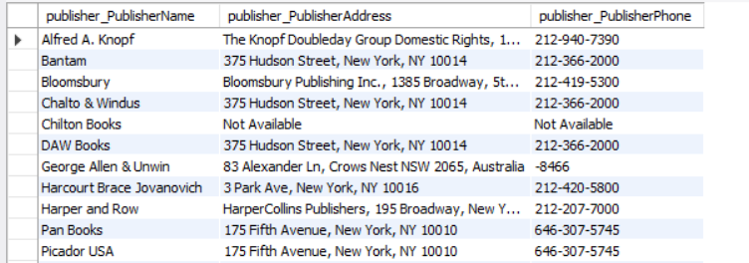
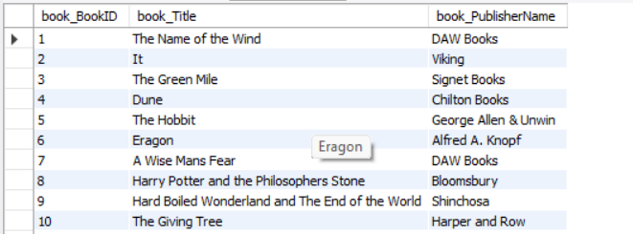
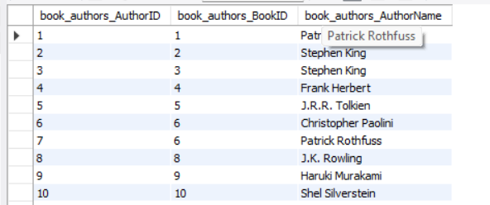
DATABASE SCHEMA
Tbl-book
Tbl-Publisher
Tbl_book_authors

Slide 9
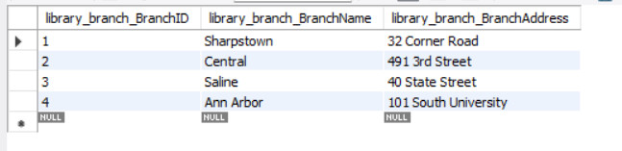
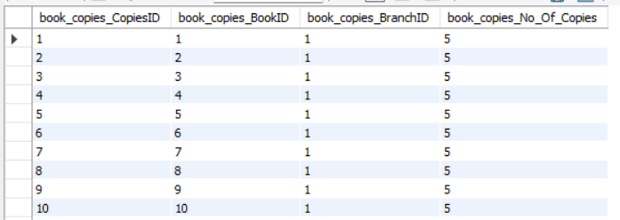
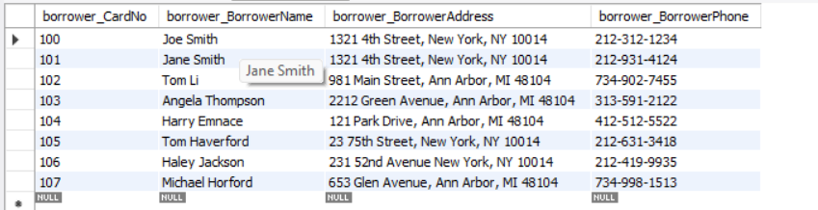
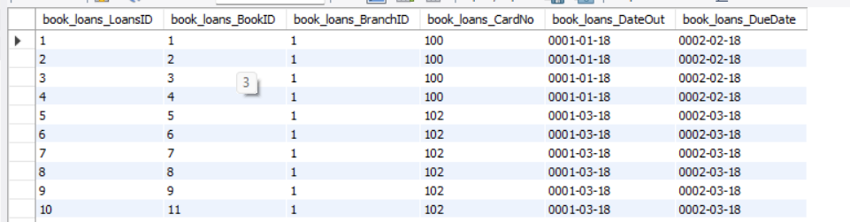
DATABASE SCHEMA
tbl_library_branch
tbl_book_copies
tbl_borrower
tbl_book_loans

Slide 10
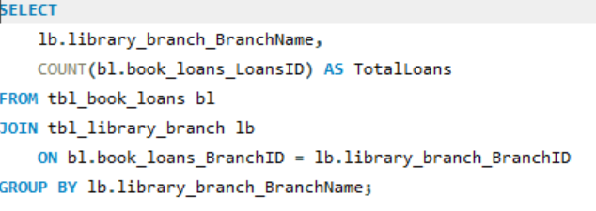
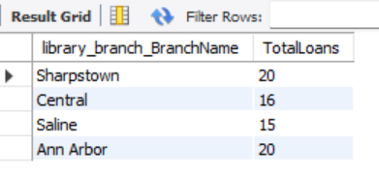
Key Analysis Questions For each library branch, retrieve the branch name and the total number of books loaned out from that branch.
Joins the book loans table with the library branch table to match loans with branch names.
Uses COUNT() and GROUP BY to calculate the total number of books loaned from each branch.

Slide 11
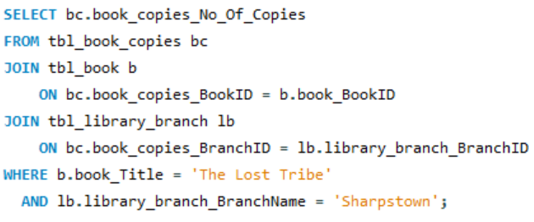
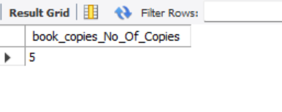
How many copies of the book titled "The Lost Tribe" are owned by the library branch whose name is "Sharps town"?
Joins the book, book copies, and library branch tables to connect the book title with its branch copies.
Filters results to show the number of copies of “The Lost Tribe” available in the Sharpstown branch.

Slide 12
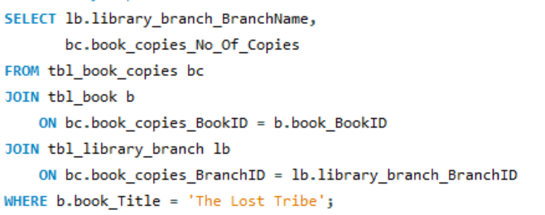
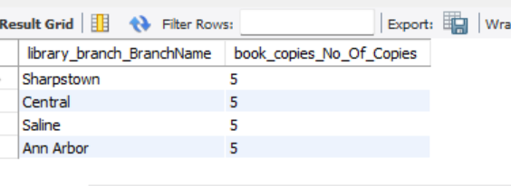
How many copies of the book titled "The Lost Tribe" are owned by each library branch?
Joins the book, book copies, and library branch tables to link the book title with all branches.
Displays each branch name along with the number of copies of “The Lost Tribe” owned by that branch.

Slide 13
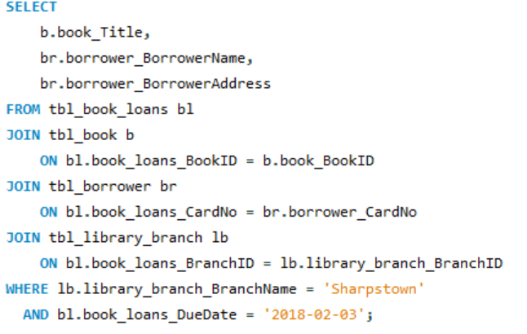
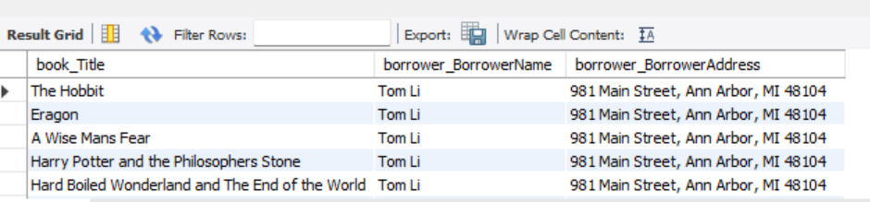
For each book that is loaned out from the "Sharpstown" branch and whose Due Date is 2/3/18, retrieve the book title, the borrower's name, and the borrower's address.
Joins the book loans, book, borrower, and library branch tables to get complete loan details.
Filters records for the Sharpstown branch with Due Date = 02-03-2018 and displays the book title, borrower name, and address.

Slide 14
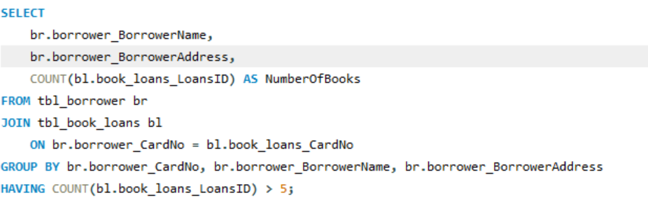
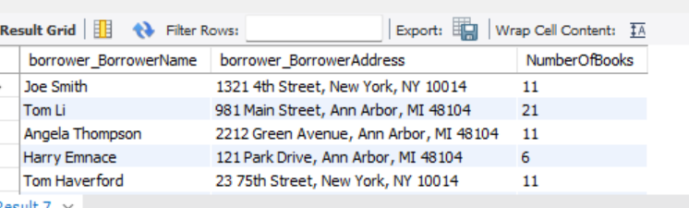
Retrieve the names, addresses, and number of books checked out for all borrowers who have more than five books checked out.
The query counts how many books each borrower has checked out by grouping loan records per borrower. It then displays only those borrowers whose total checked-out books are more than five.

Slide 15
Final Business Insights and Recommendations
Key Insights
Loan activity varies across library branches, indicating differences in user demand and branch utilization
A small group of borrowers is responsible for a higher number of book loans, showing repeat borrowing behavior
Books by popular authors consistently attract demand across multiple branches
Recommendations
Increase the number of copies for high-demand books to reduce waiting time and improve user satisfaction
Track frequent borrowers to ensure fair and balanced access to library resources
Optimize inventory distribution by reallocating books based on branch-wise demand patterns

Slide 16
Conclusion
Successfully designed and implemented a robust relational database for a library management system
Effectively utilized SQL queries to answer real-world business and operational questions
Gained strong understanding of database schema design, relationships, and constraints
Demonstrated the practical application of SQL in analyzing and managing real-world data scenarios

Slide 17
Experience & Challenges – SQL Data Analysis Project
Gained hands-on experience in designing relational databases using primary and foreign keys
Improved understanding of table relationships and data normalization
Worked with complex SQL queries involving multiple JOINs, GROUP BY, and HAVING clauses
Faced challenges in handling date formats and maintaining referential integrity
Learned to troubleshoot query errors and optimize SQL logic
Overall, the project strengthened analytical thinking and problem-solving skills

Slide 18


